Slide 1

UVM Verification for ALU Design (ALU 8051)
Group 2

Slide 2

Table of contents
01
02
03
04
What is UVM
Project Idea & Test Plan
Results
UVM Testbench

Slide 3

01
UVM

Slide 4
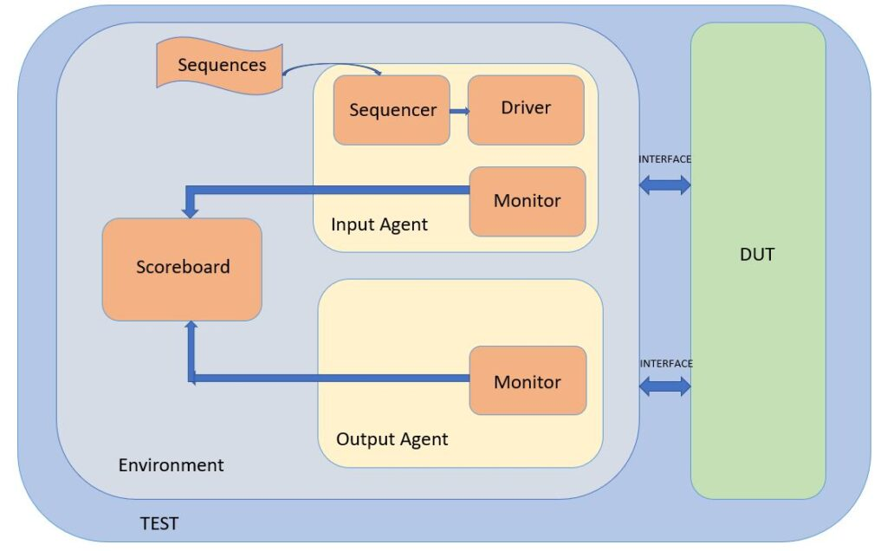
What is UVM?
Universal Verification Methodology (UVM) is a standardized framework used in the verification of integrated circuits. Developed by Accellera, UVM provides a modular and reusable approach to building testbenches, ensuring thorough and efficient verification of complex designs.

Slide 5
Advantages of UVM

Slide 6

02
Test Plan
Project Idea and Test Plan

Slide 7
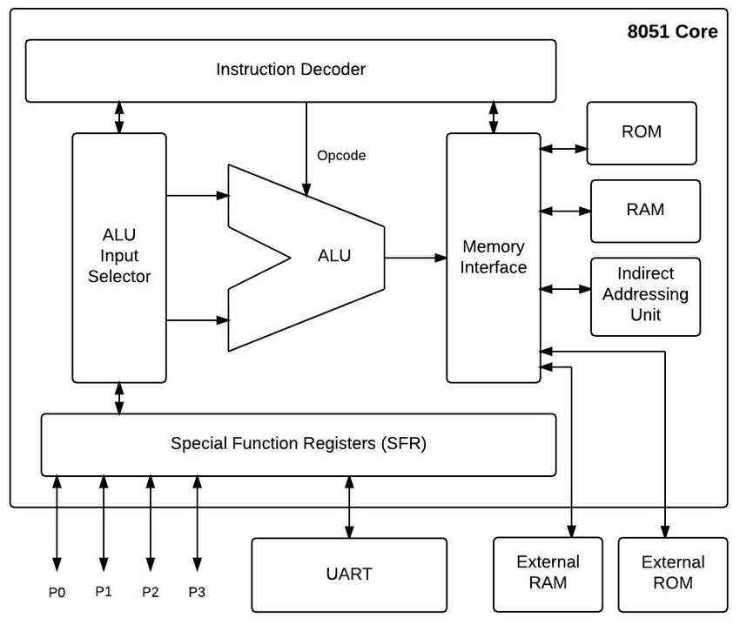
Project Idea
This project aims to verify the Arithmetic Logic Unit (ALU) of the 8051 microprocessor using the Universal Verification Methodology (UVM). The 8051 ALU is responsible for performing essential arithmetic and logic operations, which are critical to the microcontroller's overall functionality. Ensuring its correct operation is paramount for the reliability of any system using the 8051.

Slide 8
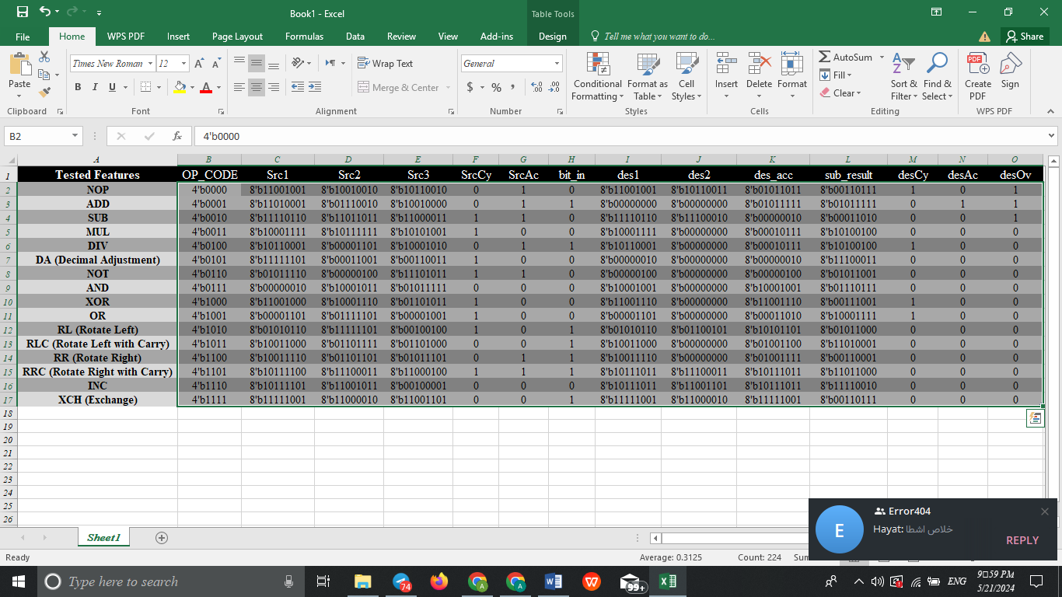
TEST PLAN

Slide 9

03
UVM Testbench

Slide 10
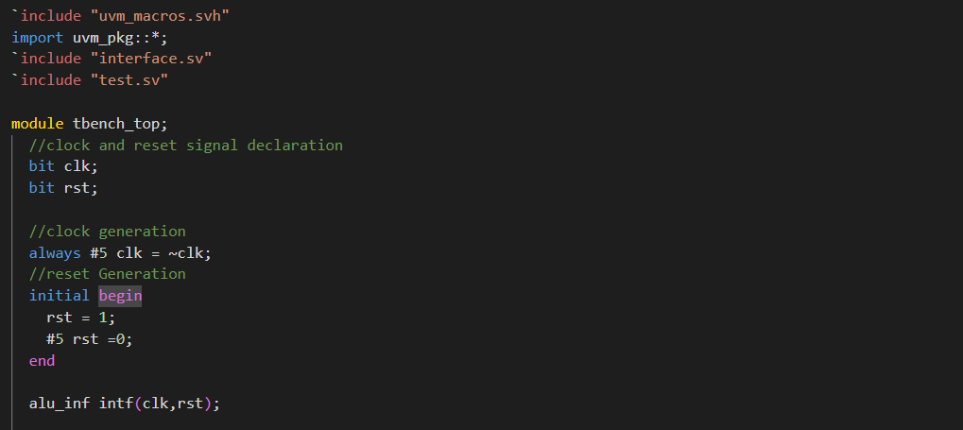
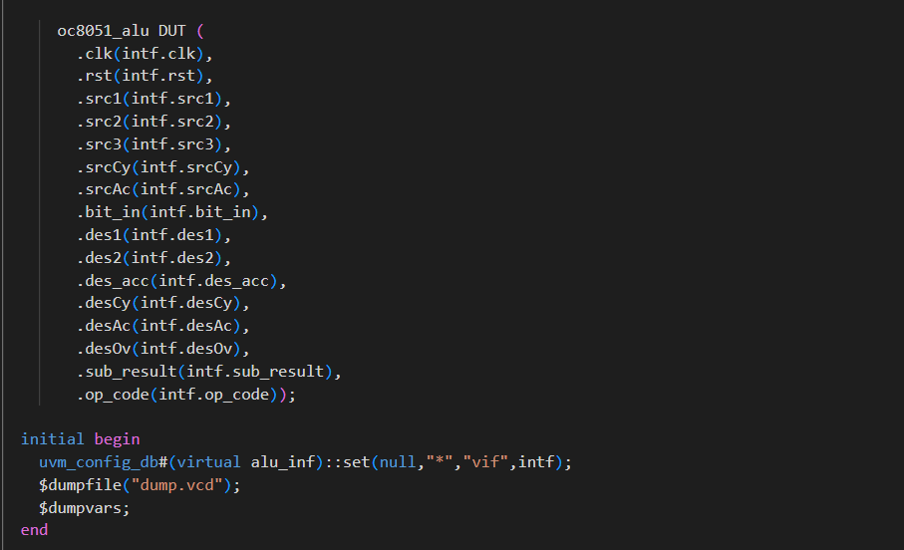
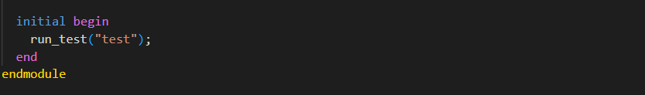
Test bench

Slide 11
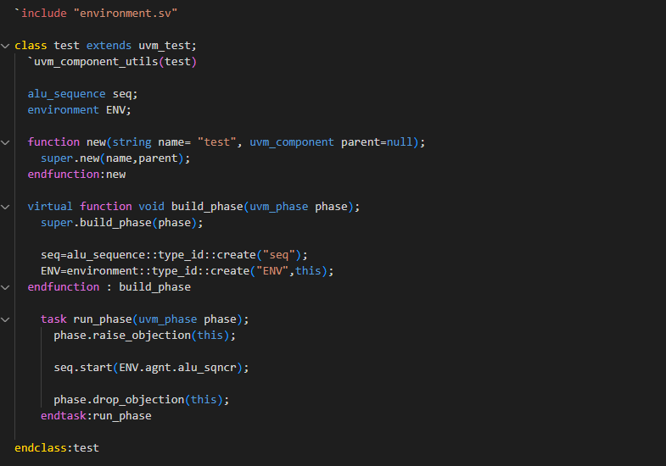
Test

Slide 12
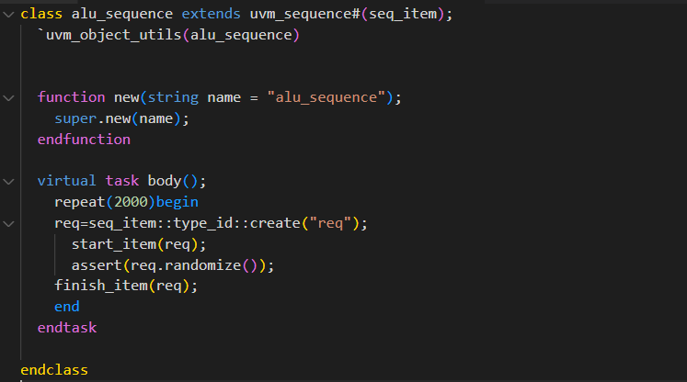
Sequence

Slide 13
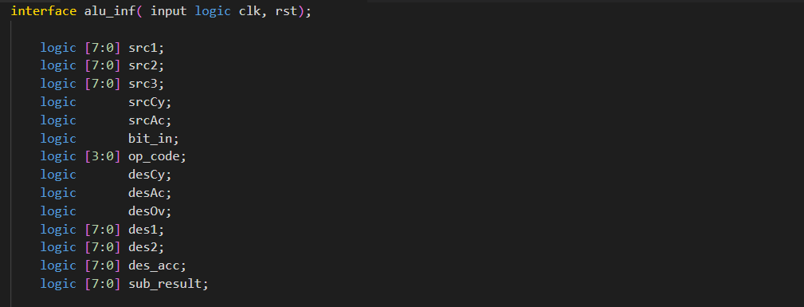
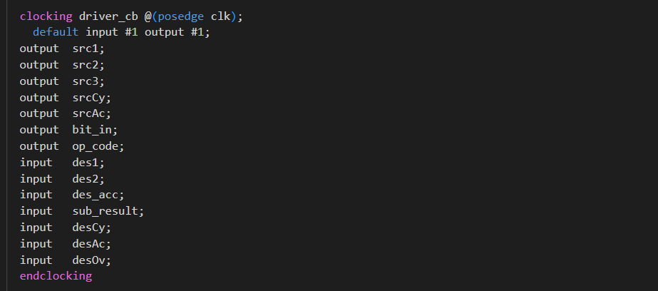
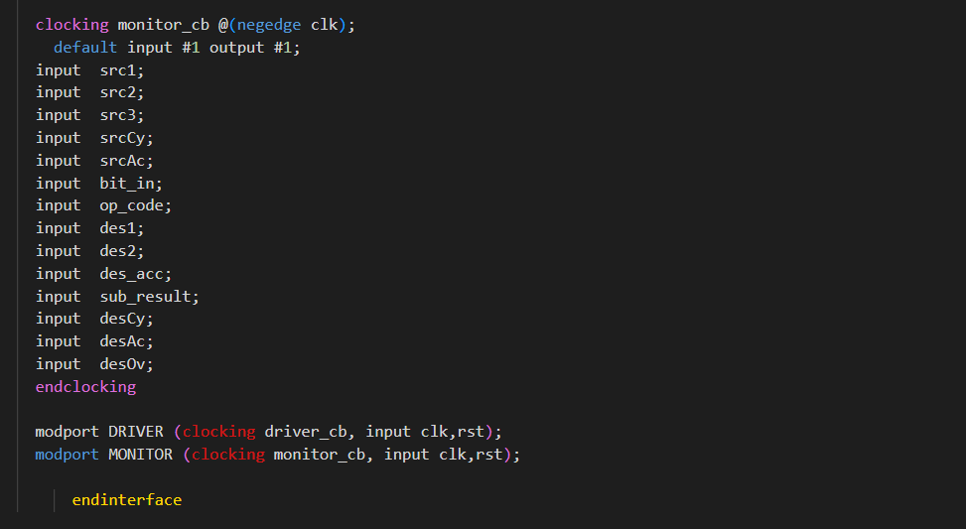
Interface

Slide 14
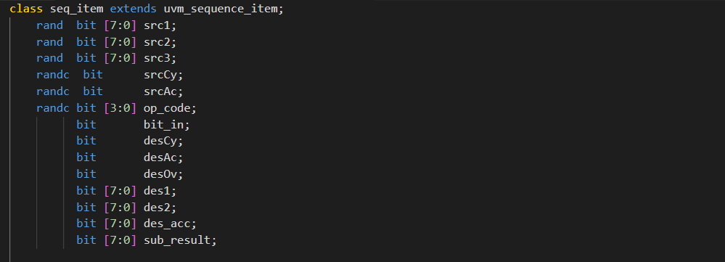
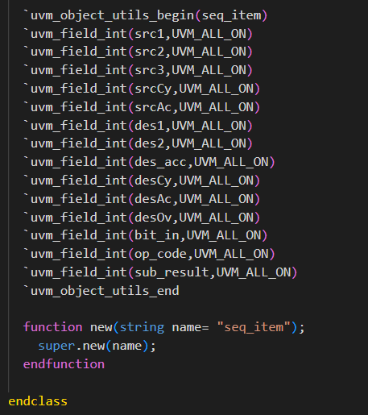
Sequence Items

Slide 15
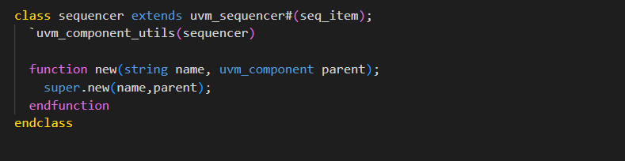
Sequencer

Slide 16
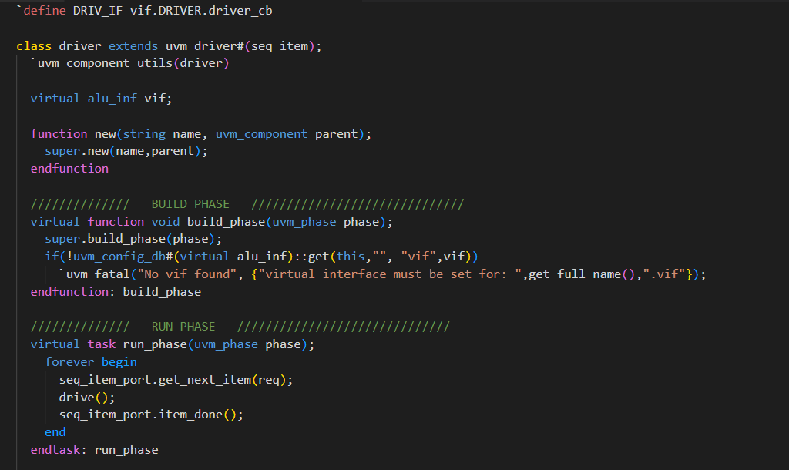
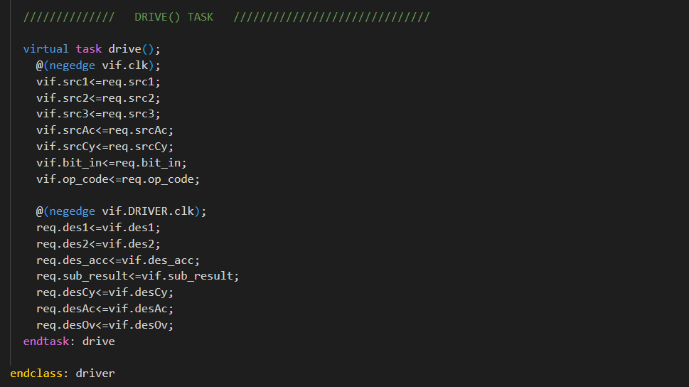
Driver

Slide 17
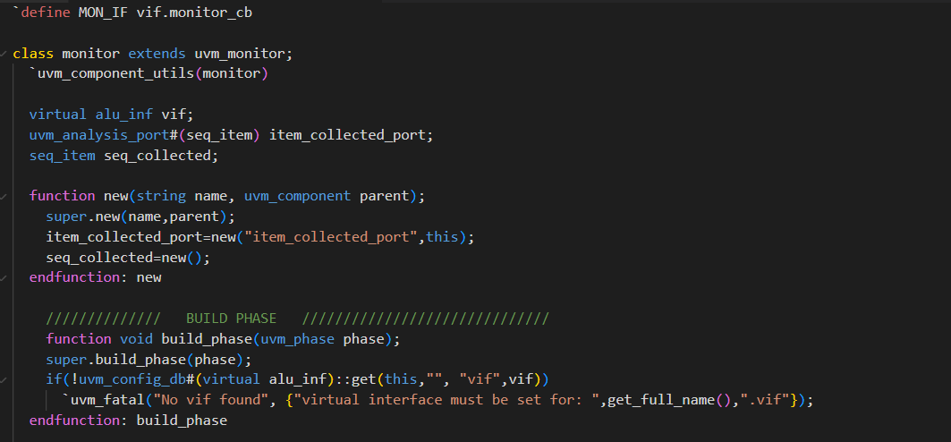
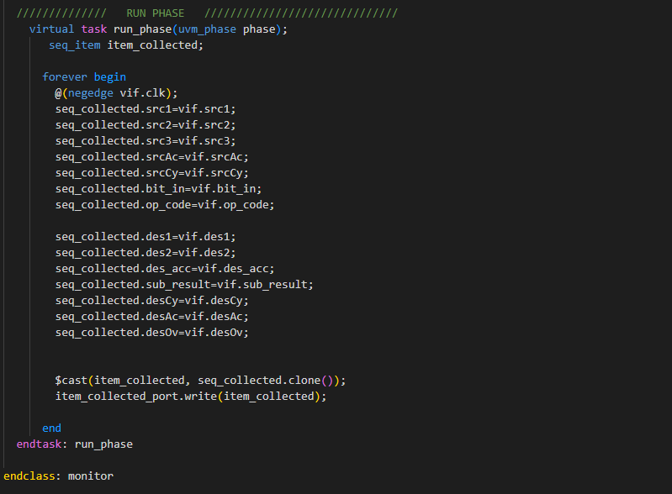
Monitor

Slide 18
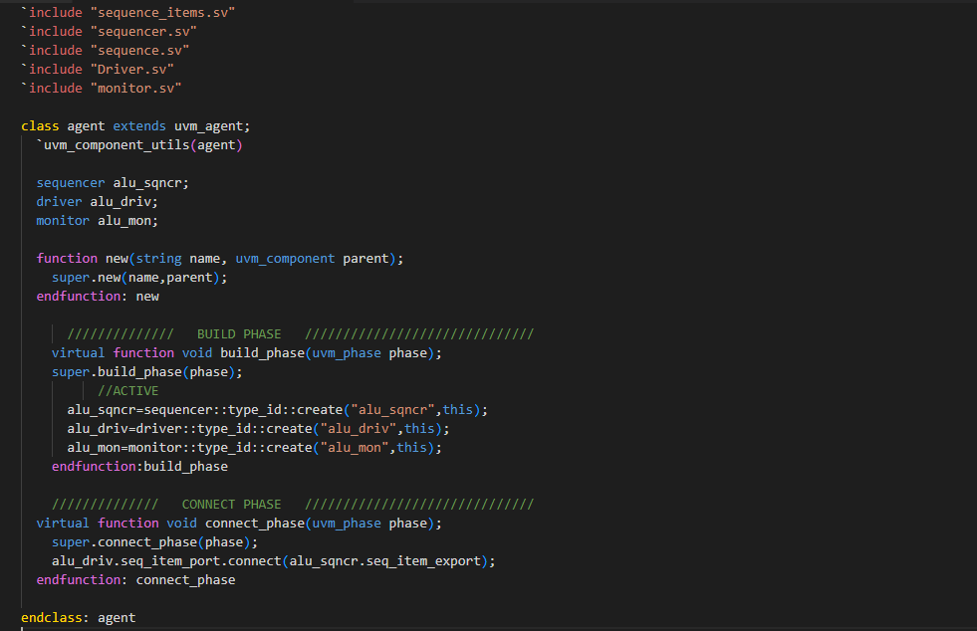
Agent

Slide 19
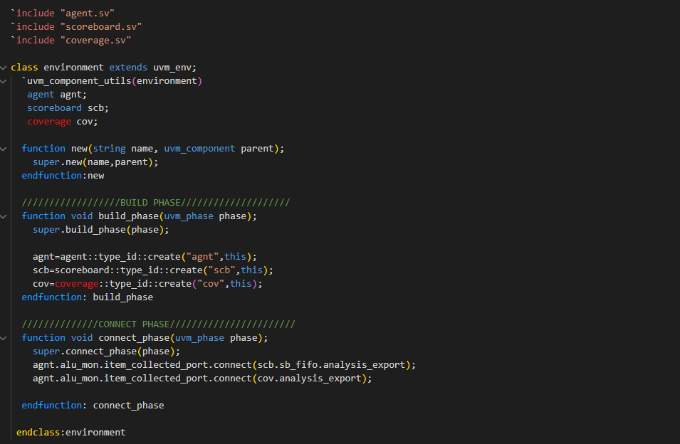
Environment

Slide 20
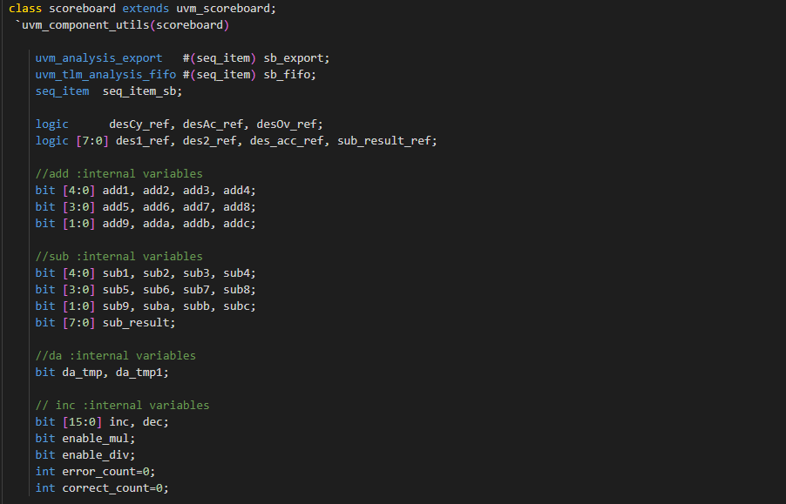
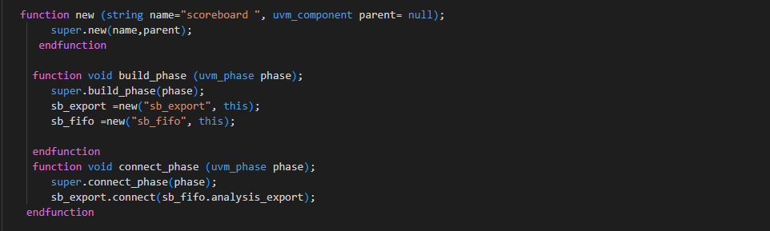
Scoreboard

Slide 21
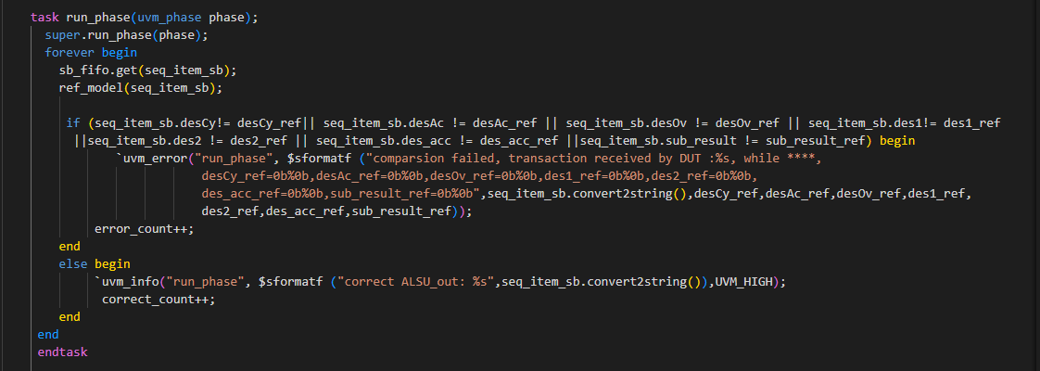
Scoreboard

Slide 22
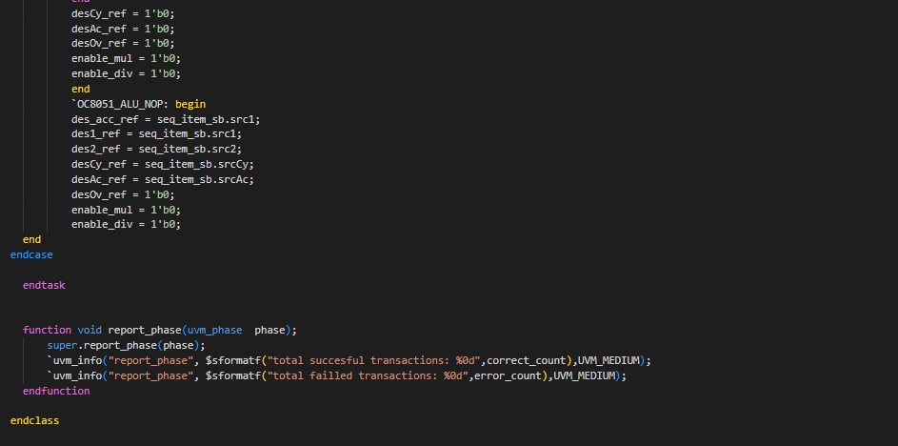
Scoreboard

Slide 23
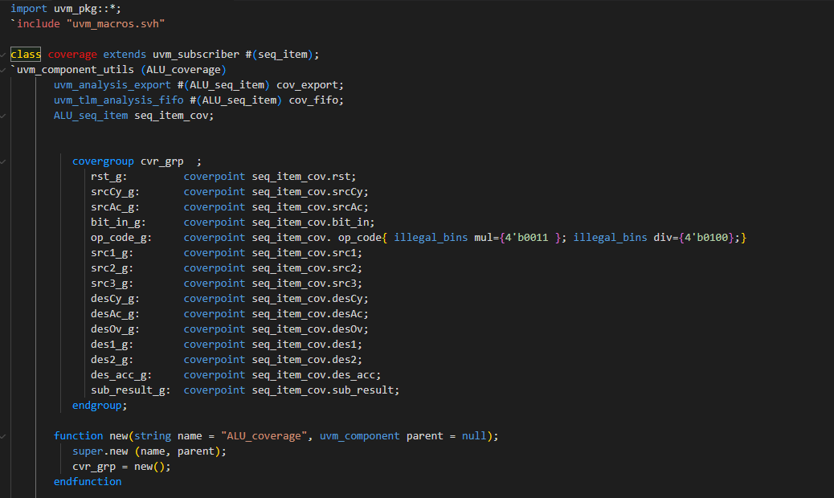
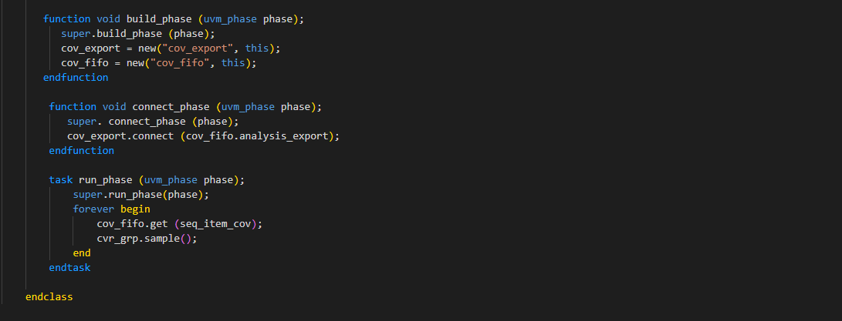
Coverage

Slide 24

04
Results & Reports

Slide 25
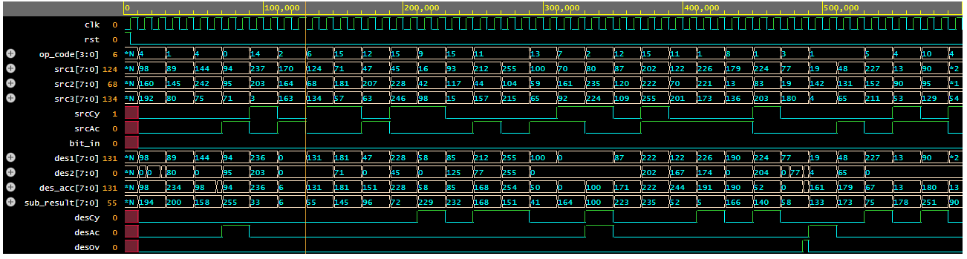
Waveform

Slide 26
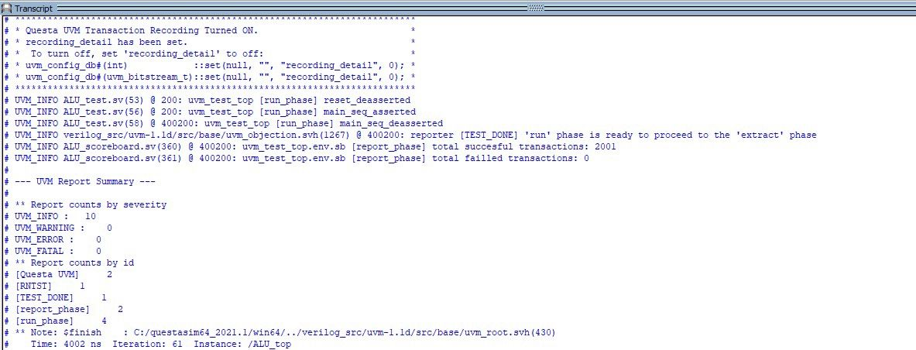
UVM Summary Report

Slide 27
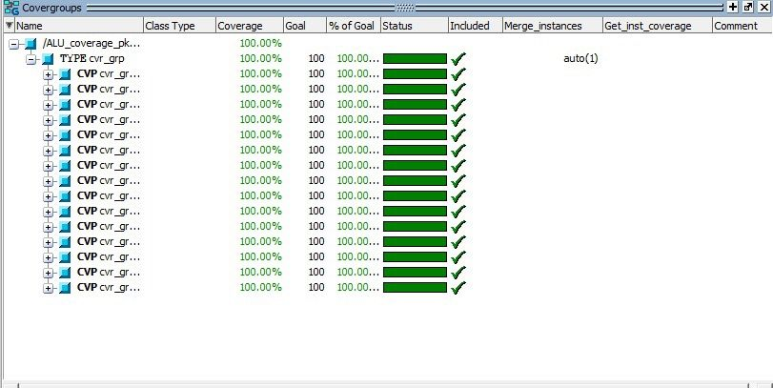
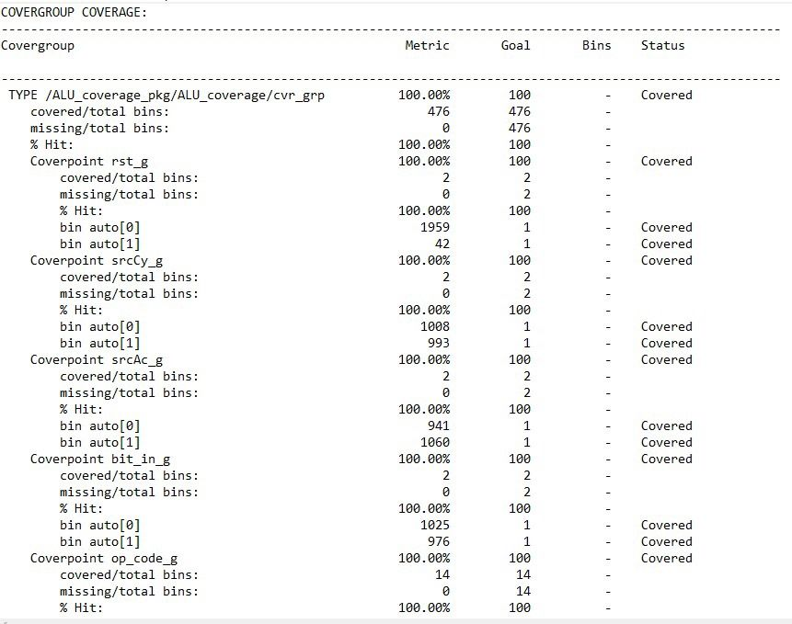
Coverage Reports

Slide 28
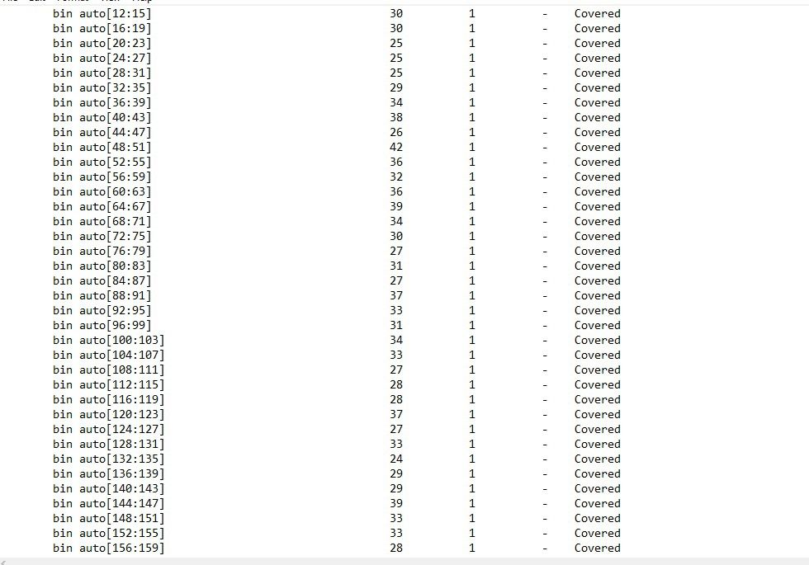
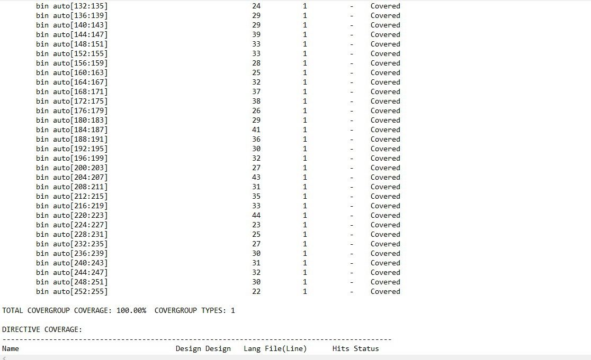
Coverage Reports

Slide 29

THANK YOU

